Slide 1
DataVerse Data visualization for Finance
Group 6
Aadarsha Chapagain (C0825975)
Rajasekhar katta (C0833766)
Venkata sai manikanta Ponakala (c0833772)
Rishi Phaneendra Varma Bhupathi Raju(C0825285)

Slide 2
Contents
Project Title and Description
What is DataVerse ?
Project Team
Business Case
Credit card spending Visualisation
Technology & Resource
Key Stakeholder List
Stakeholder Requirements as known
Product Description

Slide 3
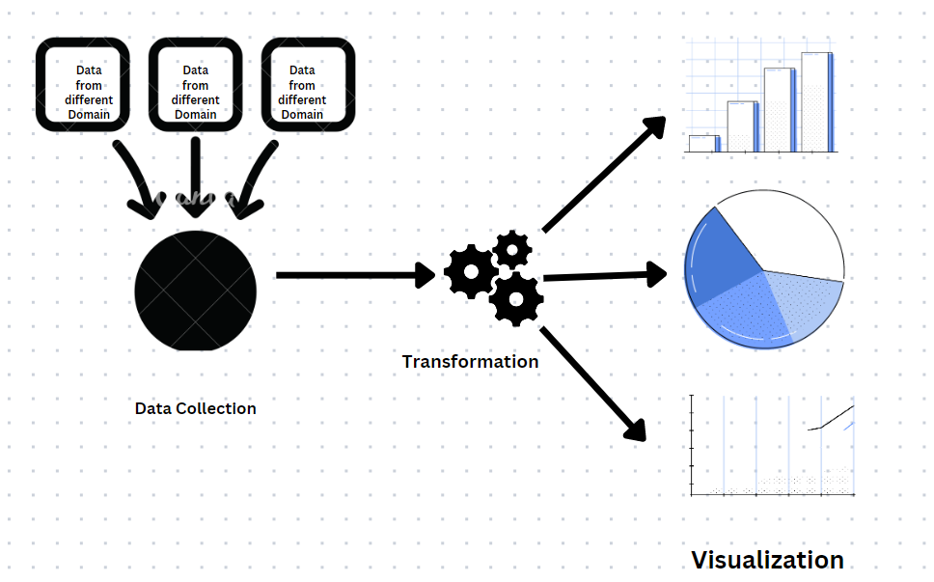
What is DataVerse

Slide 4
Project Title and description
Financial institutions are struggling to get insights from their data
Excel is not enough to handle huge amount of data
Just Accumulating data won’t add any value to organization
Companies utilizing data as an information assets are ahead of the game
Dataverse is a data visualization project where data from financial institutions will be collected, transformed and visualized

Slide 5
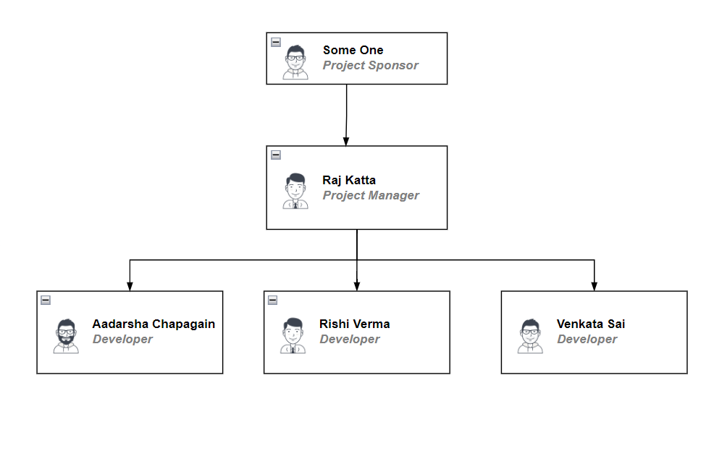
Project Team

Slide 6
Business Case
This project targets banking customers when and how they are likely to be most amenable to making a purchase.
This provides information to help optimize banking marketing efforts. This knowledge can involve anything. Client may design a new product or service and know when and where to market them.
Additionally, if a client experiencing a slowdown in sales, the data will provide insights into what is wrong.

Slide 7
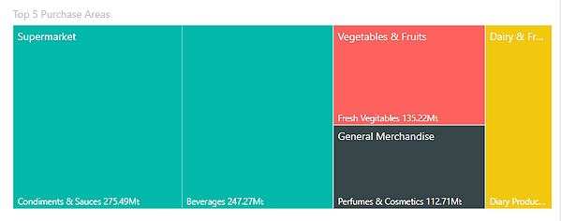
Credit card spending Visualisation

Slide 8
Technology & Resource
This project leverages Microsoft Azure Public Cloud services as Pay-as-you-Go subscription to avoid capital investments and operational maintenance.
Rajasekhar katta will be the Project Manager and Data modeler.
Rishi Varma will be appointed as Data Engineer.
Aadarsha Chapagain will be an Azure Devops developer.
Venkata Sai Manikanta will be PowerBI developer.

Slide 9
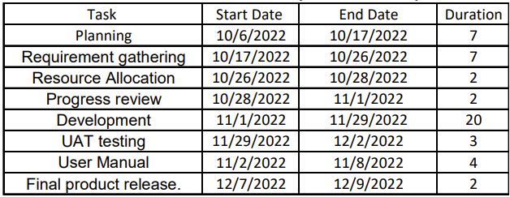
WBS

Slide 10
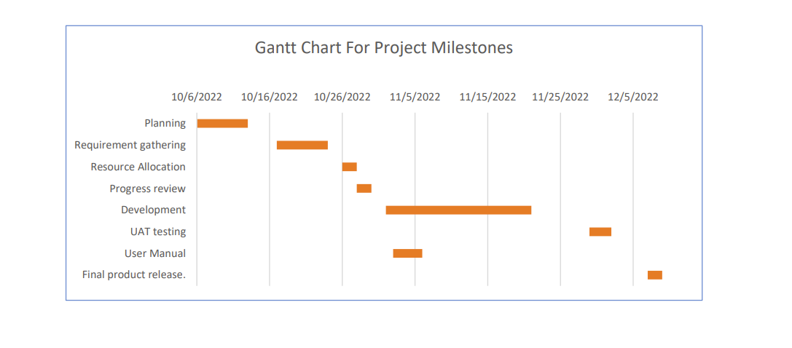
WBS contd.

Slide 11
Key Stakeholder List
Customers
Project Manager
Project Team Members
Company Executives
Project Sponsor
Steering Committee
An Advisory group providing guidance on key decision's on sponsor, executives and key stakeholders

Slide 12
Stakeholder Requirements as known
Business unit: Enterprise Business Intelligence (EBI)
Business Operations
Customers
Subject Matter Experts

Slide 13
Product Description
This project aims to help the clients by reaching the banking customers and shows when they are most likely to be open to making a purchase.
By creating the PowerBI dashboard with all the required data the client can access lot of information about their customers spending patterns in a simple way.
This will provide the information about the customers purchase history, their spending limits and many more.

Slide 14
Key Deliverables
Customers spending patterns
Big purchases in last 6 months
How many times they exceed the credit limit in past 2 years
Repaying on time or not
Their top 5 spending product categories
All these insights will be presented on PowerBI Dashboard

Slide 15
Assumption Made
Project costs are within the budget
Always keep track of resources
Determine the changes to the project precisely that will affect project progress,
All team resources complete work on time,
Project timeline can be met

Slide 16
Constraints
WBS must complete within 2 weeks
Cost
Scope
Set of deliverables that a project manager gaurantees

Slide 17
Project approval requirements
Governmental requirements,
Capital Requirements,
Operational requirements

Slide 18
Project Risks
Project purpose and need is not well defined
Project design and deliverables definition is incomplete
Project schedule is not clearly defined

Slide 19
Project exit criteria
Verify all tests planned have been run
Verify all technical requirements have been met
Verify all quality issues has been resolved
All results are captured and documented
All test metrics are collected environment is backup up

Slide 20
References
https://learn.microsoft.com/en-us/power-bi/fundamentals/service-get-started
https://learn.microsoft.com/en-us/power-bi/create-reports/service-dashboard-create
https://truelayer.com/blog/data-chain-retrieving/
https://docsumo.com/blog/best-bank-data-extraction-software
https://www.inetco.com/use-cases/credit-and-debit-card-analytics/

